Slide 1

AMMWEC’s
National Coalition Conference 2026
UNITED AGAINST ANTISEMITISM & HATE:
Protecting Our Communities
July 13, 2026
Washington DC
#AMMWEC #AMMWECCoalition #Antisemitism #HatehurtsUsAll #UniteAgainstHate

Slide 2

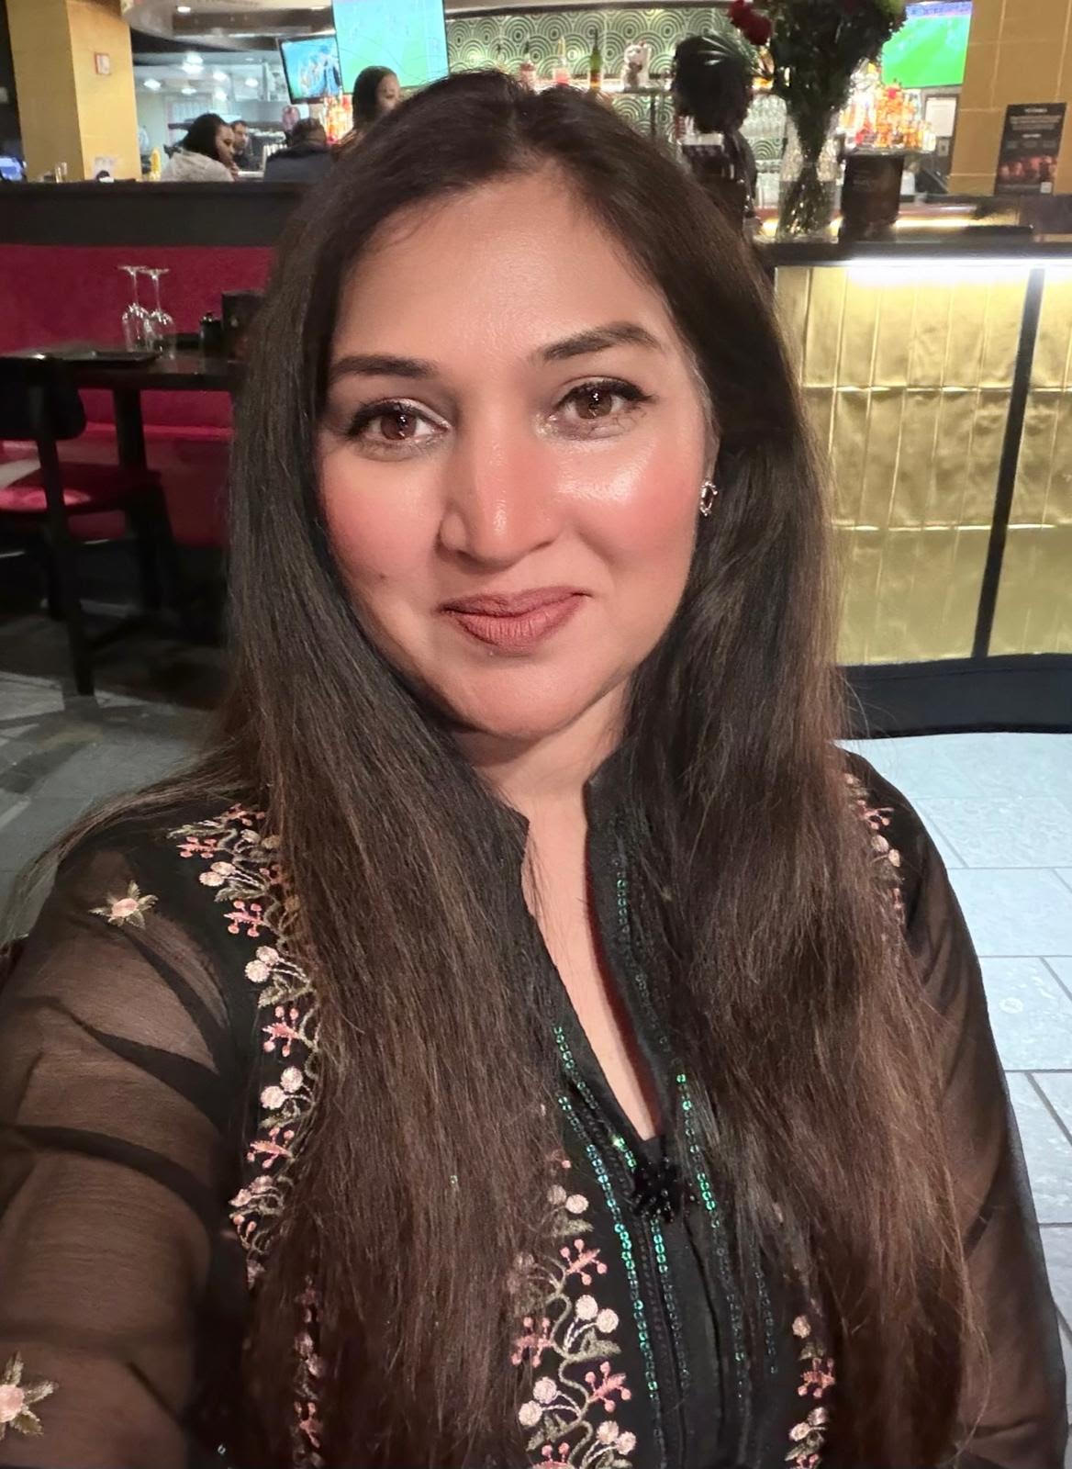
SEEMAB ASIF
Board Member, AMMWEC
Christian Faith Leader
Notes:
Seemab Asif:
Good morning, everyone, and welcome to the AMMWEC National Coalition Against Antisemitism & Hate Conference.
My name is Seemab Asif. I am honored to serve as a member of the AMMWEC Board, and I am also proud to stand here as a Christian faith leader committed to peace, dignity, and unity among all people.
Today, we gather as Muslims, Jews, Christians, and friends of many backgrounds with one shared purpose: to stand together against antisemitism, hate, extremism, and division, and to affirm our common humanity.
To begin this important day, I ask everyone to please rise for the National Anthem, performed by Ghazal Mizrahi, an Iranian Jewish singer and peacemaker.

Slide 3
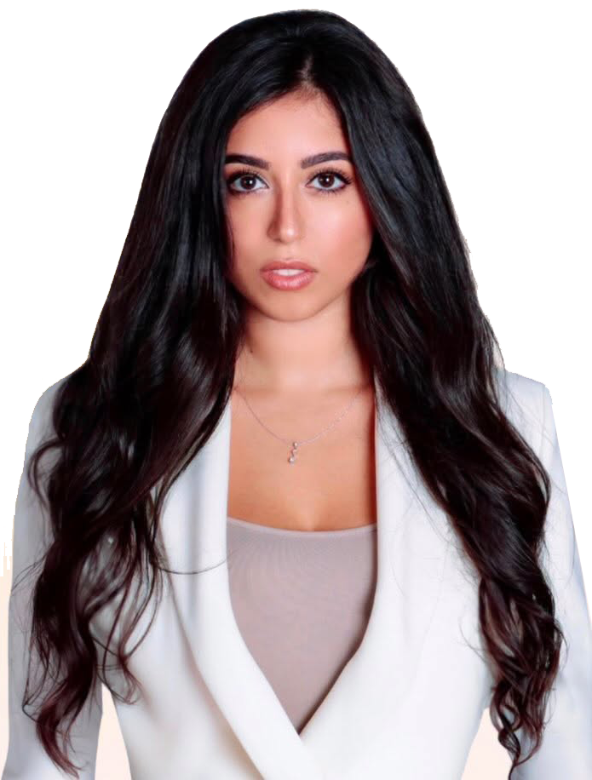
AMMWEC’s National Coalition
Conference 2026
Opening Ceremony
National Anthem
Ghazal Mizrahi
Notes:
Seemab introducing (Ghazal Mizrahi singing the National Anthem]

Slide 4
AMMWEC’s
National Coalition Conference 2026
UNITED AGAINST ANTISEMITISM & HATE:
Protecting Our Communities
July 13, 2026
Washington DC
#AMMWEC #AMMWECCoalition #Antisemitism #HatehurtsUsAll #UniteAgainstHate
Notes:
Seemab
Thank you, Ghazal, for that beautiful and moving performance.
Now we begin our Abrahamic Prayer for Peace.
I would like to invite our three Abrahamic faith leaders to come forward to the podium.
First, representing the Jewish faith, please welcome Rabbi Alex Harris.
Next, representing the Christian faith, please welcome Pastor Leon Benjamin.
Next, representing the Muslim faith, please welcome Imam Sajjad Ahmad
And representing please welcome Sheikh Musa Drammeh, AMMWEC Advisory Board Member and Muslim Imam from New York.
These three leaders will now offer prayers of peace, unity, and moral courage as we begin our conference.

Slide 5
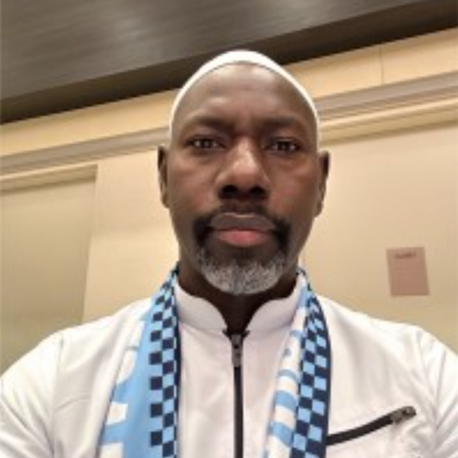
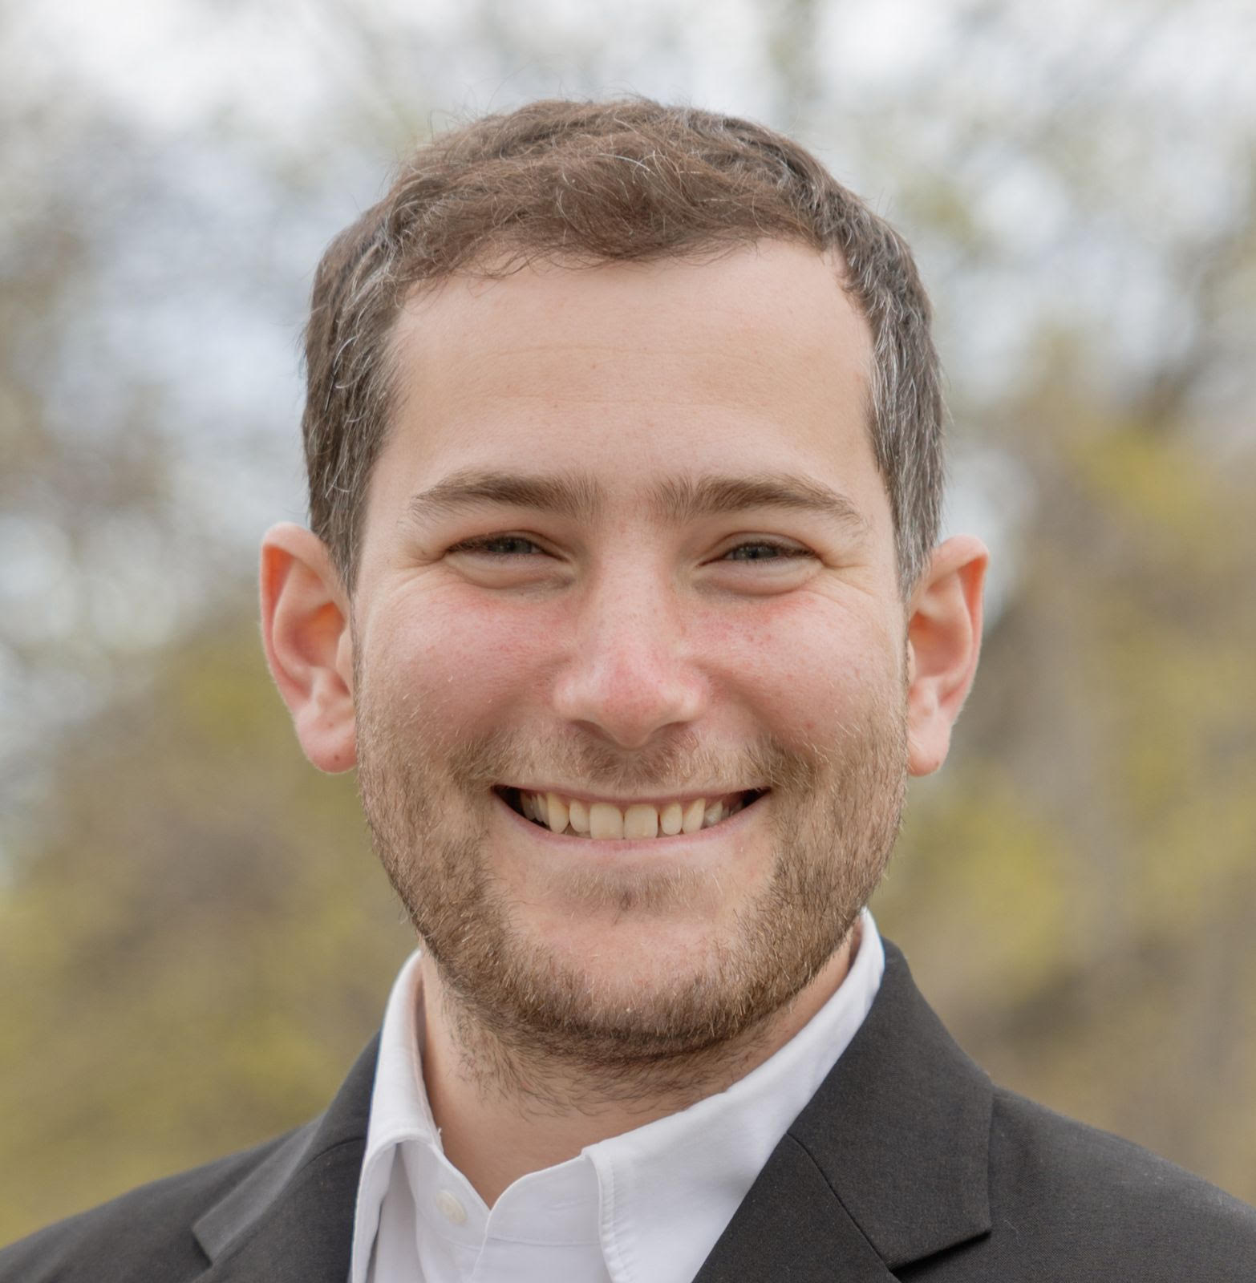
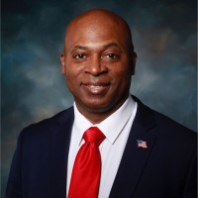
Abrahamic Prayer for Peace
Imam Musa Drammeh
Rabbi Alex Harris
Pastor Leon Benjamin
Notes:
[Rabbi Alex Harris comes to the podium]
Rabbi Harris, please lead us in the Jewish prayer for peace.
[Rabbi Alex Harris offers invocation] 2-3 mins
Thank you, Rabbi Harris.
[Pastor Leon Benjamin comes to the podium]
Pastor Benjamin, please lead us in the Christian prayer for peace.
[Pastor Leon Benjamin offers invocation] 2-3 mins
Thank you, Pastor Benjamin.
[Sheikh Musa Drammeh comes to the podium] 2-3 mins
Sheikh Musa Drammeh, please lead us in the Muslim prayer for peace.
[Sheikh Musa Drammeh offers invocation]
Here is a short script to add after Sheikh Musa Drammeh’s Islamic prayer:

Slide 6
AMMWEC’s
National Coalition Conference 2026
UNITED AGAINST ANTISEMITISM & HATE:
Protecting Our Communities
Interfaith Cake Cutting
July 13, 2026
Washington DC
Notes:
After the Islamic Prayer — Interfaith Cake Cutting

Slide 7
AMMWEC’s
National Coalition Conference 2026
UNITED AGAINST ANTISEMITISM & HATE:
Protecting Our Communities
July 13, 2026
Washington DC
#AMMWEC #AMMWECCoalition #Antisemitism #HatehurtsUsAll #UniteAgainstHate
Notes:
Seemab Asif:
Ladies and gentlemen, we now move to our first panel: “Muslim Delegations to Israel — Eyewitness Accounts.”
This is one of the most important conversations of our conference because it brings together Muslim, South Asian, Pakistani, Bangladeshi, Canadian, and American voices who traveled to Israel and saw the country for themselves.
It is now my honor to introduce our moderator, Wajid Ali Syed.
Wajid Ali Syed is a renowned journalist, filmmaker, documentary film producer, author, and researcher. He is also the CEO of Abraham Publishing and Research Center, and the author and publisher of the new book based on Muslim eyewitness accounts from Israel.
Please join me in welcoming Wajid Ali Syed.

Slide 8
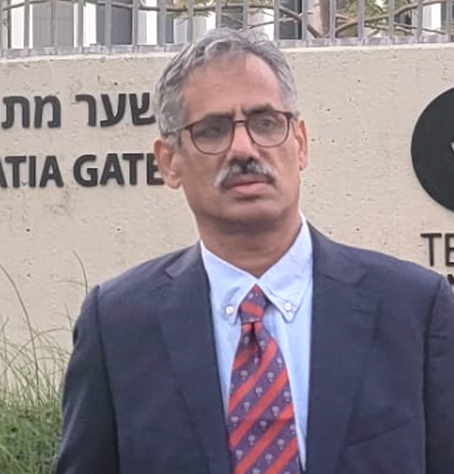
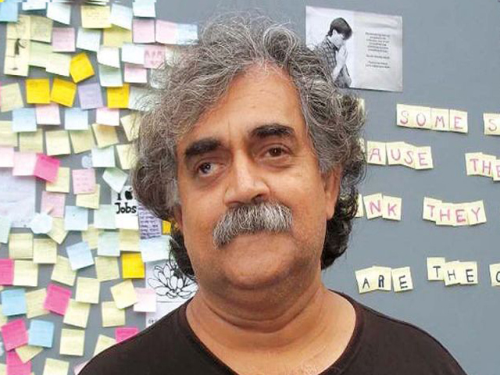
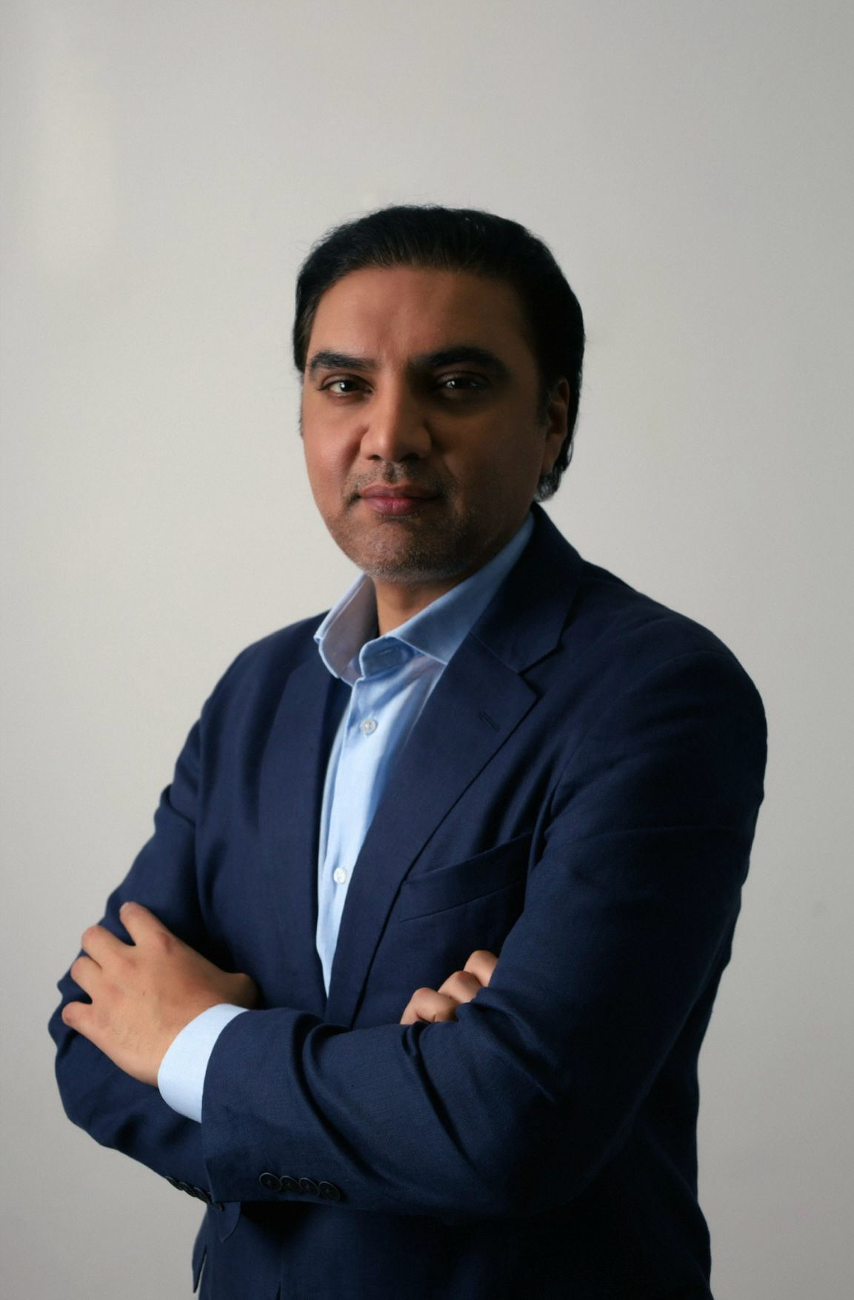
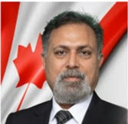
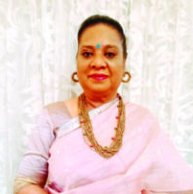
Panel 1: Muslim Delegations to Israel — Eyewitness Accounts —
Panelists
Ahmed Naeem
Hasan Mujtaba
Moderator:
Wajid Ali Syed
Abid Nisar
Sitara Naheed
Notes:
Wajid Ali Syed:
Thank you, Seemab, and thank you to AMMWEC for creating this important platform.
This panel is about truth. Many Muslims and South Asians grow up hearing only one version of Israel — a version shaped by politics, propaganda, fear, and misinformation. But when people travel there, meet Israelis, meet Jews, Muslims, Christians, Arabs, Druze, Bedouins, immigrants, refugees, women leaders, soldiers, students, and survivors, they discover a much more diverse and complex society.
Today, our panelists will share what they witnessed directly. This is not theory. This is testimony.
Because we have many powerful voices and limited time, we will divide this panel into two groups. I ask each panelist to keep answers brief and focused so everyone has equal time.

Slide 9
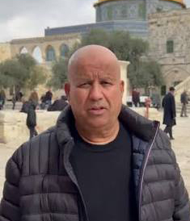
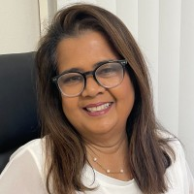
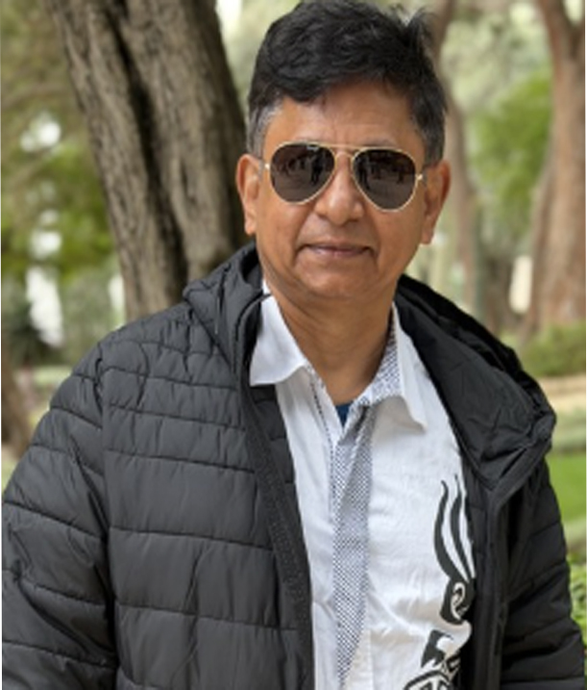
Panel 2: Muslim Delegations to Israel — Eyewitness Accounts
Syed Anwar Wasti
Moderator:
Wajid Ali Syed;
Sonali Tucker
Mohammad Saifur Rahman Chowdhury
#AMMWEC #AMMWECCoalition #Antisemitism #HatehurtsUsAll #UniteAgainstHate

Slide 10
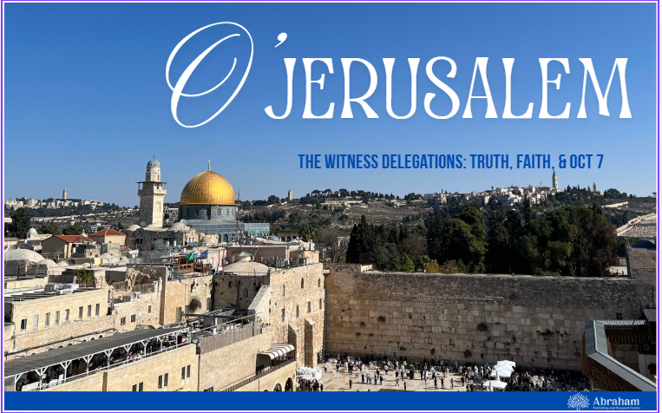
Networking Lunch
Book signing by Muslim Participants to Israel Delegations

Slide 11
AMMWEC’s
National Coalition Conference 2026
UNITED AGAINST ANTISEMITISM & HATE:
Protecting Our Communities
July 13, 2026
Washington DC
#AMMWEC #AMMWECCoalition #Antisemitism #HatehurtsUsAll #UniteAgainstHate
Notes:
Seemab Asif:
Seemab Asif:
Thank you to Wajid Ali Syed and all of our panelists for that powerful conversation.
We now move to our keynote remarks by Carol Ann Schwartz of Hadassah.
Carol Ann Schwartz is Hadassah’s 28th national president. She has more than 30 years of service to Hadassah at the local, regional and national levels, including serving as a member of the Board of Directors and as national secretary and national vice president.
An ardent Zionist leader, Carol Ann represents Hadassah around the globe. In addition to being a board member of the World Zionist Organization, she also she serves on the AZM (American Zionist Movement) Board, Conference of Presidents of Major Jewish American Organizations Board and JNF-USA Board of Governors.
She has been active in her local community on boards and committees, including Adath Israel Synagogue, Jewish Federation of Cincinnati, Hillel and others.
Carol Ann earned a Bachelor of Business Administration in marketing and management from the University of Cincinnati and a Master of Business Administration in finance from Xavier University. Following seven-plus years in banking, Carol Ann took another path to work with her family in commercial real estate.
Carol Ann and her husband, Michael, have been married for 40 years and have three children. They have all traveled to Israel many times, and their oldest son lives in Israel and has served in the IDF.
This moment is deeply meaningful because when women come together, great things happen. When a Muslim & multifaith women’s organization and a Jewish women’s organization stand together, we show what courage, friendship, and shared purpose can build.
At AMMWEC, we believe that when women speak — and when women speak to each other — families, communities, and society improve.
Hadassah has long represented Jewish women’s leadership, love for Israel, healing, advocacy, and moral courage. AMMWEC is proud to stand with Hadassah in the fight against antisemitism, hate, and extremism

Slide 12
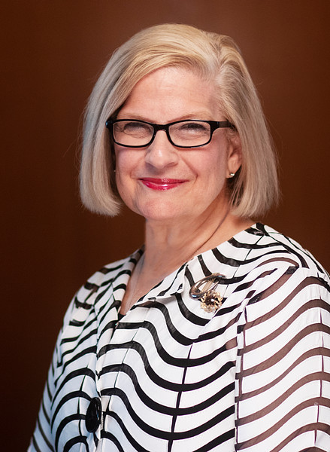
Keynote Remarks:
Carol Ann Schwartz
President
HADASSAH
serves on the AZM (American Zionist Movement) Board, Conference of Presidents of Major Jewish American Organizations Board and JNF-USA Board of Governors.
#AMMWEC #AMMWECCoalition #Antisemitism #HatehurtsUsAll #UniteAgainstHate
Notes:
Please join me in welcoming Carol Ann Schwartz to address the audience.

Slide 13
AMMWEC’s
National Coalition Conference 2026
UNITED AGAINST ANTISEMITISM & HATE:
Protecting Our Communities
July 13, 2026
Washington DC
#AMMWEC #AMMWECCoalition #Antisemitism #HatehurtsUsAll #UniteAgainstHate
Notes:
Seemab Asif:
Seemab Asif:
Thank you to Wajid Ali Syed and all of our panelists for that powerful conversation.
We now move to our keynote remarks by Carol Ann Schwartz of Hadassah.
Carol Ann Schwartz is Hadassah’s 28th national president. She has more than 30 years of service to Hadassah at the local, regional and national levels, including serving as a member of the Board of Directors and as national secretary and national vice president.
An ardent Zionist leader, Carol Ann represents Hadassah around the globe. In addition to being a board member of the World Zionist Organization, she also she serves on the AZM (American Zionist Movement) Board, Conference of Presidents of Major Jewish American Organizations Board and JNF-USA Board of Governors.
She has been active in her local community on boards and committees, including Adath Israel Synagogue, Jewish Federation of Cincinnati, Hillel and others.
Carol Ann earned a Bachelor of Business Administration in marketing and management from the University of Cincinnati and a Master of Business Administration in finance from Xavier University. Following seven-plus years in banking, Carol Ann took another path to work with her family in commercial real estate.
Carol Ann and her husband, Michael, have been married for 40 years and have three children. They have all traveled to Israel many times, and their oldest son lives in Israel and has served in the IDF.
This moment is deeply meaningful because when women come together, great things happen. When a Muslim & multifaith women’s organization and a Jewish women’s organization stand together, we show what courage, friendship, and shared purpose can build.
At AMMWEC, we believe that when women speak — and when women speak to each other — families, communities, and society improve.
Hadassah has long represented Jewish women’s leadership, love for Israel, healing, advocacy, and moral courage. AMMWEC is proud to stand with Hadassah in the fight against antisemitism, hate, and extremism

Slide 14
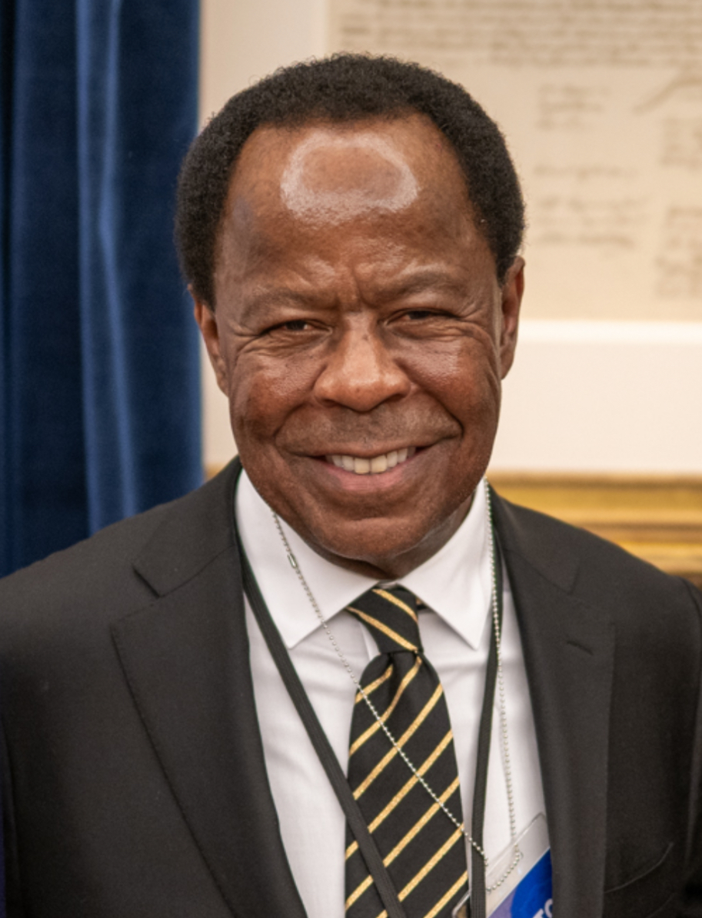
Keynote Address
Leo Terrel
An American civil rights attorney, talk radio host, and current senior federal official serving as Senior Counsel to the Assistant Attorney General for the Civil Rights Division of the U.S. Department of Justice. Appointed by President Donald Trump, he additionally serves as the Chair of the multi-agency federal Task Force to Combat Anti-Semitism.
Notes:
Please join me in welcoming Carol Ann Schwartz to address the audience.

Slide 15
AMMWEC’s
National Coalition Conference 2026
UNITED AGAINST ANTISEMITISM & HATE:
Protecting Our Communities
July 13, 2026
Washington DC

Slide 16
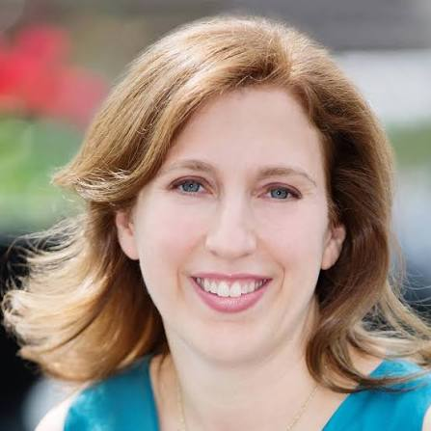
A Conversation with
Dara Horn
Award-winning American novelist and scholar Jewish history and literature, including the book People Love Dead Jews

Slide 17
AMMWEC’s
National Coalition Conference 2026
UNITED AGAINST ANTISEMITISM & HATE:
Protecting Our Communities
July 13, 2026
Washington DC

Slide 18
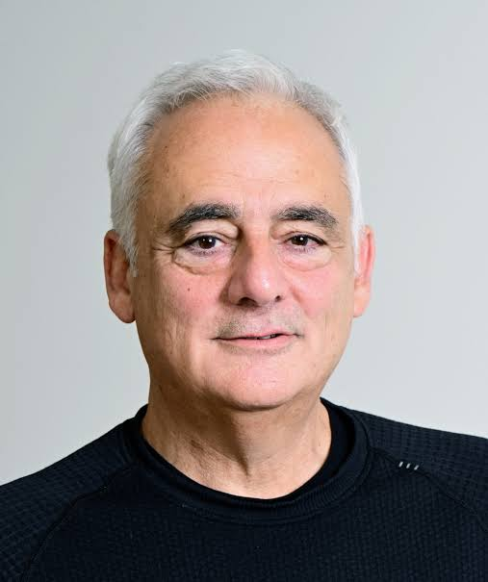
Keynote Address:
Dr. Charles Asher Small
Founding Director and President
Institute for the Study of Global Antisemitism and Policy

Slide 19
AMMWEC’s
National Coalition Conference 2026
UNITED AGAINST ANTISEMITISM & HATE:
Protecting Our Communities
July 13, 2026
Washington DC

Slide 20
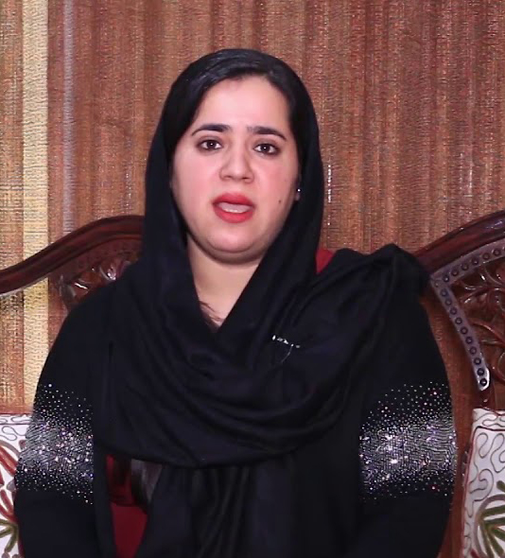
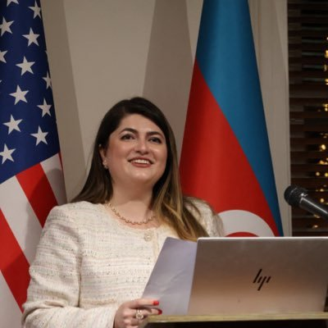
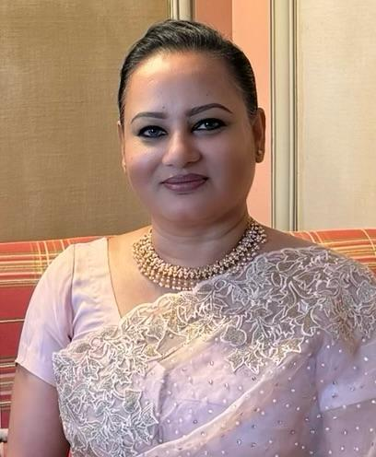
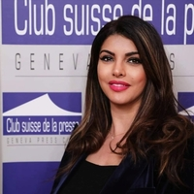
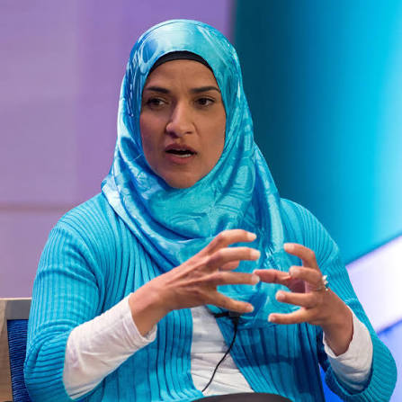
Panel 2: Muslim Women in Peacemaking
Panelists
Lima Anwari
Leyla Mammadli
Moderator:
Farhana Khorshed
Manel Msalmi
Atia Shahnaz
Notes:
Wajid Ali Syed:
Thank you, Seemab, and thank you to AMMWEC for creating this important platform.
This panel is about truth. Many Muslims and South Asians grow up hearing only one version of Israel — a version shaped by politics, propaganda, fear, and misinformation. But when people travel there, meet Israelis, meet Jews, Muslims, Christians, Arabs, Druze, Bedouins, immigrants, refugees, women leaders, soldiers, students, and survivors, they discover a much more diverse and complex society.
Today, our panelists will share what they witnessed directly. This is not theory. This is testimony.
Because we have many powerful voices and limited time, we will divide this panel into two groups. I ask each panelist to keep answers brief and focused so everyone has equal time.

Slide 21
AMMWEC’s
National Coalition Conference 2026
UNITED AGAINST ANTISEMITISM & HATE:
Protecting Our Communities
July 13, 2026
Washington DC
Notes:
Ready ADL Presentaion

Slide 22
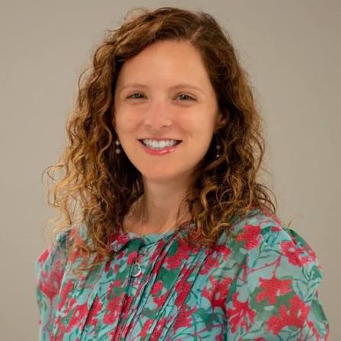
"Rising Antisemitism:
What the Data Shows and What We Must Do“
Jackie Subar,
Director of Strategic Partnerships,
ADL
Lauren Wolman,
Senior Director, Government Relations and Strategy
ADL
ADL Presentation
Notes:
Open presentation of ADL

Slide 23
AMMWEC’s
National Coalition Conference 2026
UNITED AGAINST ANTISEMITISM & HATE:
Protecting Our Communities
July 13, 2026
Washington DC

Slide 24
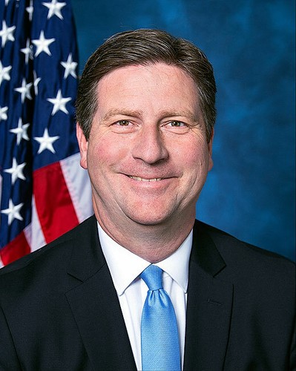
Speaker:
Congressman
Greg Stanton (AZ 04)

Slide 25
AMMWEC’s
National Coalition Conference 2026
UNITED AGAINST ANTISEMITISM & HATE:
Protecting Our Communities
July 13, 2026
Washington DC

Slide 26
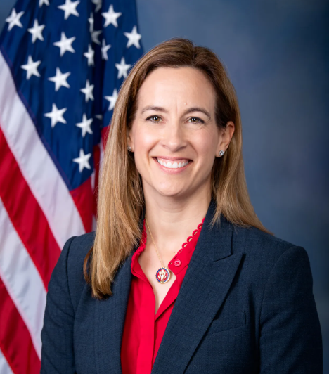
Speaker:
Governor Mikie Sherrill
Governor of New Jersey's
Play Video

Slide 27
AMMWEC’s
National Coalition Conference 2026
UNITED AGAINST ANTISEMITISM & HATE:
Protecting Our Communities
July 13, 2026
Washington DC

Slide 28
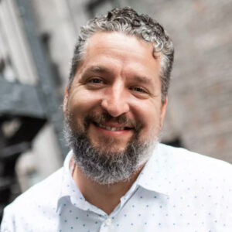
Keynote Address:
Luke Moon
A prominent conservative Christian activist, writer, and ordained Southern Baptist minister who specializes in international affairs, human rights, and religious advocacy.
Video White Rose

Slide 29
AMMWEC’s
National Coalition Conference 2026
UNITED AGAINST ANTISEMITISM & HATE:
Protecting Our Communities
July 13, 2026
Washington DC

Slide 30
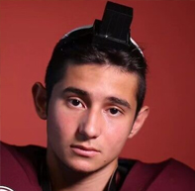
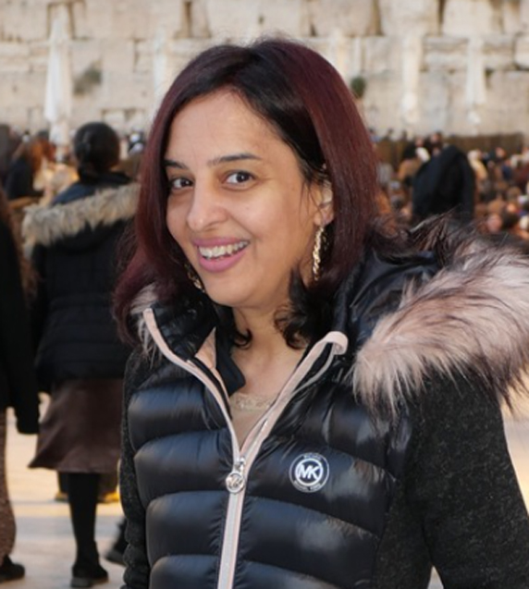
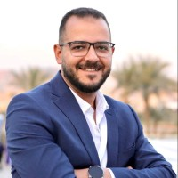
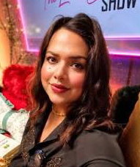
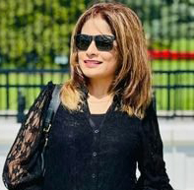
Panel 3: Interfaith Digital Creators and Influencers
Panelists:
Sam Salz
Muniza Ansari
Moderator:
Michael Gamal
Leena Shah
Aaliya Shah

Slide 31
AMMWEC’s
National Coalition Conference 2026
UNITED AGAINST ANTISEMITISM & HATE:
Protecting Our Communities
July 13, 2026
Washington DC

Slide 32
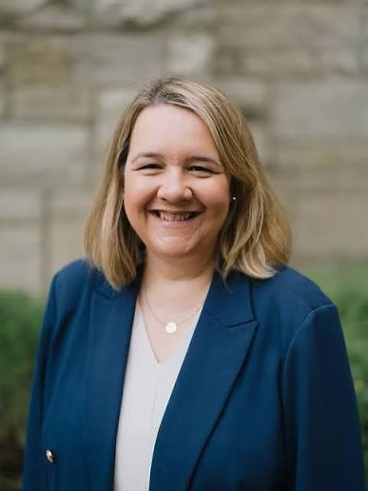
Interfaith and Spiritual Life
Featured Speaker:
Reverend Kristen Glass Perez
University Chaplain at The George Washington University (GW),
She leads the Center for Interfaith and Spiritual Life,
focusing on multifaith community building, emotional and spiritual care,
and student advocacy.

Slide 33
AMMWEC’s
National Coalition Conference 2026
UNITED AGAINST ANTISEMITISM & HATE:
Protecting Our Communities
July 13, 2026
Washington DC

Slide 34
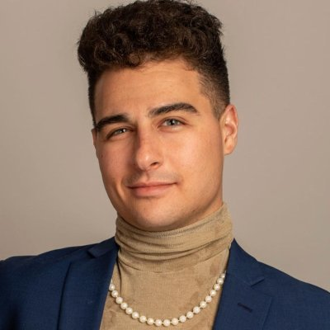
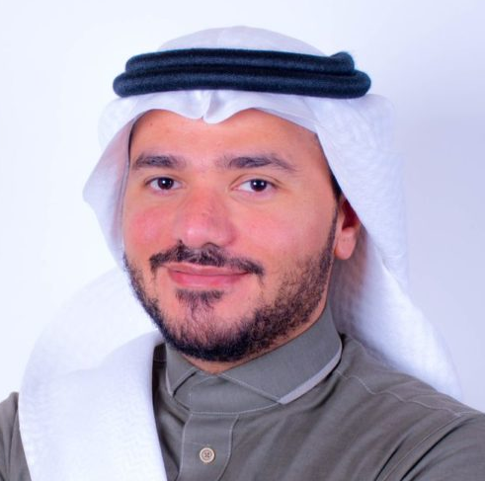
Video Address
Zack Sage Fox
Loay Al Shareef
Play Video
Play Video

Slide 35
AMMWEC’s
National Coalition Conference 2026
UNITED AGAINST ANTISEMITISM & HATE:
Protecting Our Communities
July 13, 2026
Washington DC

Slide 36
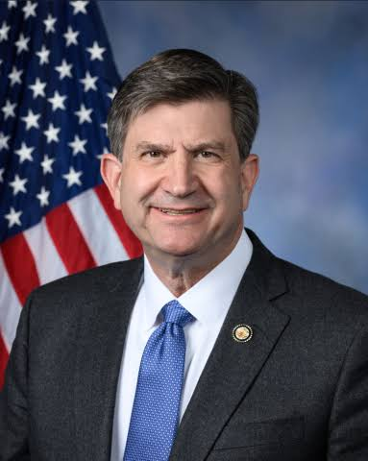
Speaker:
Brad Schneider (IL)
Congressman

Slide 37
AMMWEC’s
National Coalition Conference 2026
UNITED AGAINST ANTISEMITISM & HATE:
Protecting Our Communities
July 13, 2026
Washington DC

Slide 38
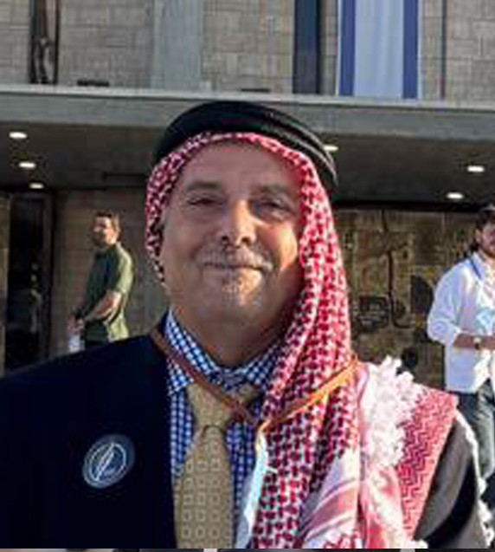
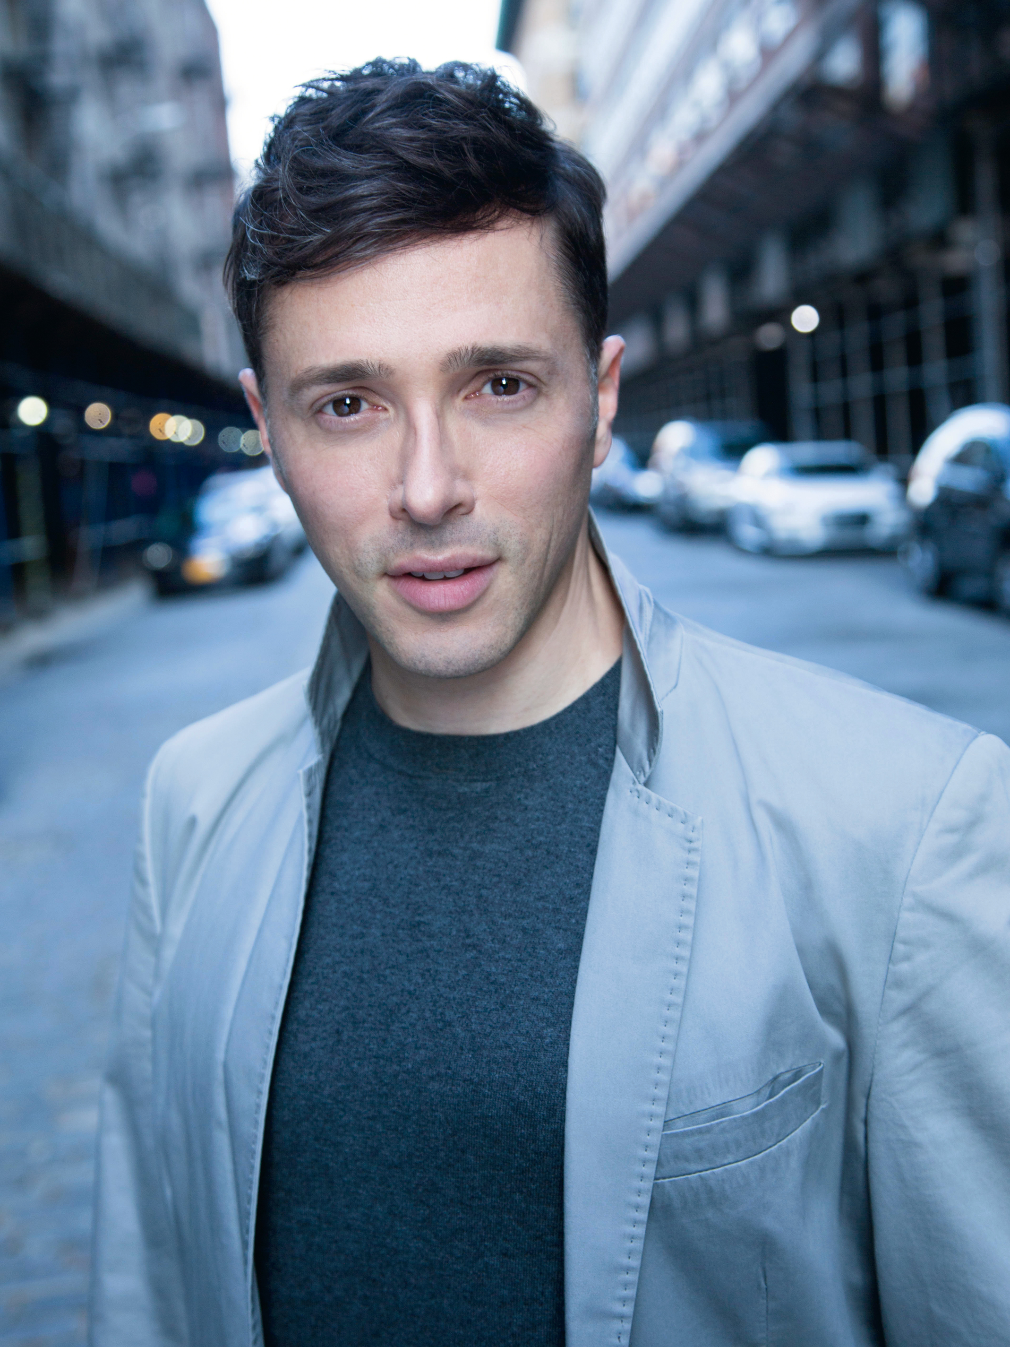
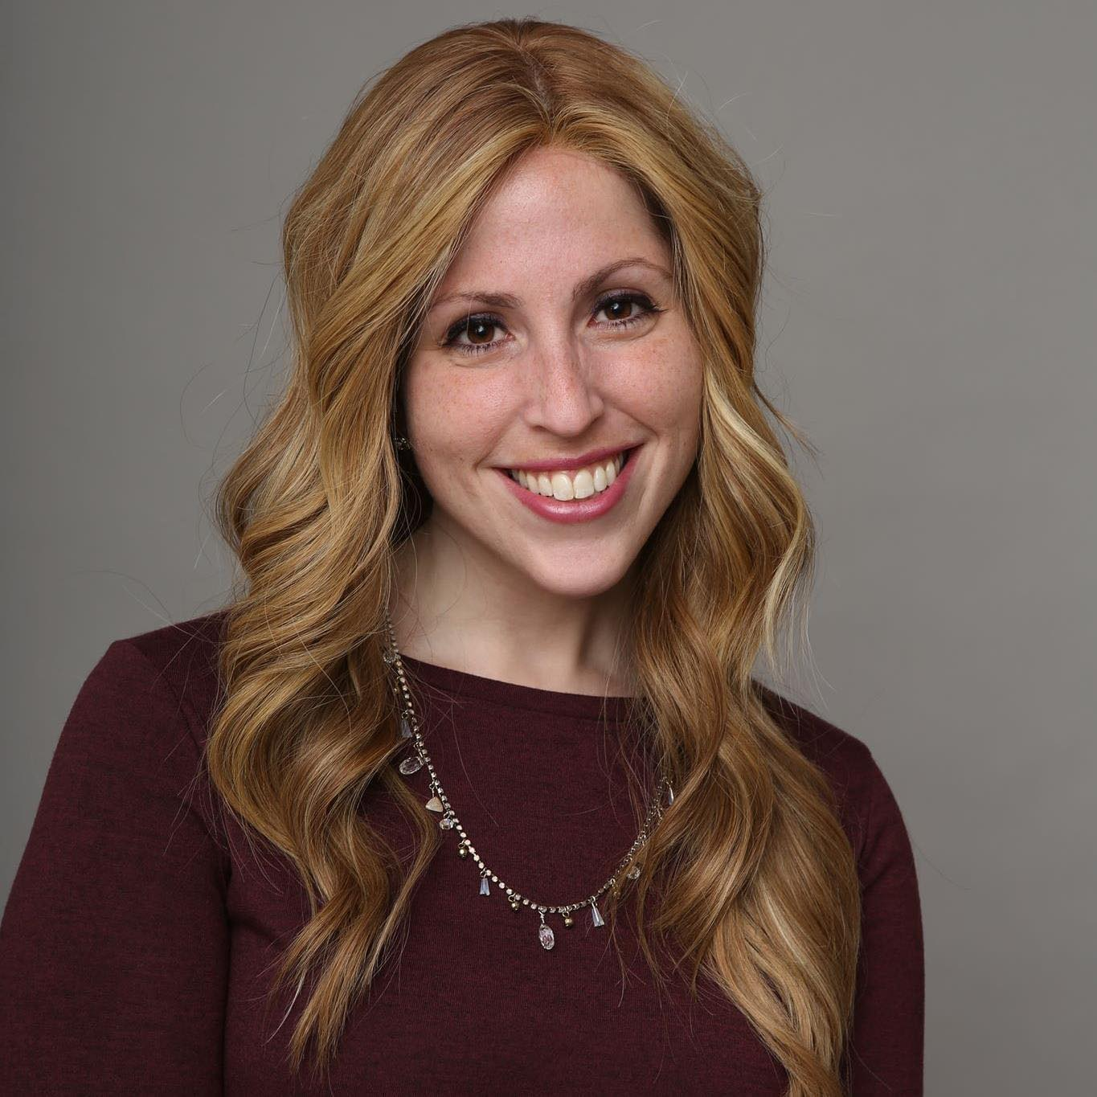
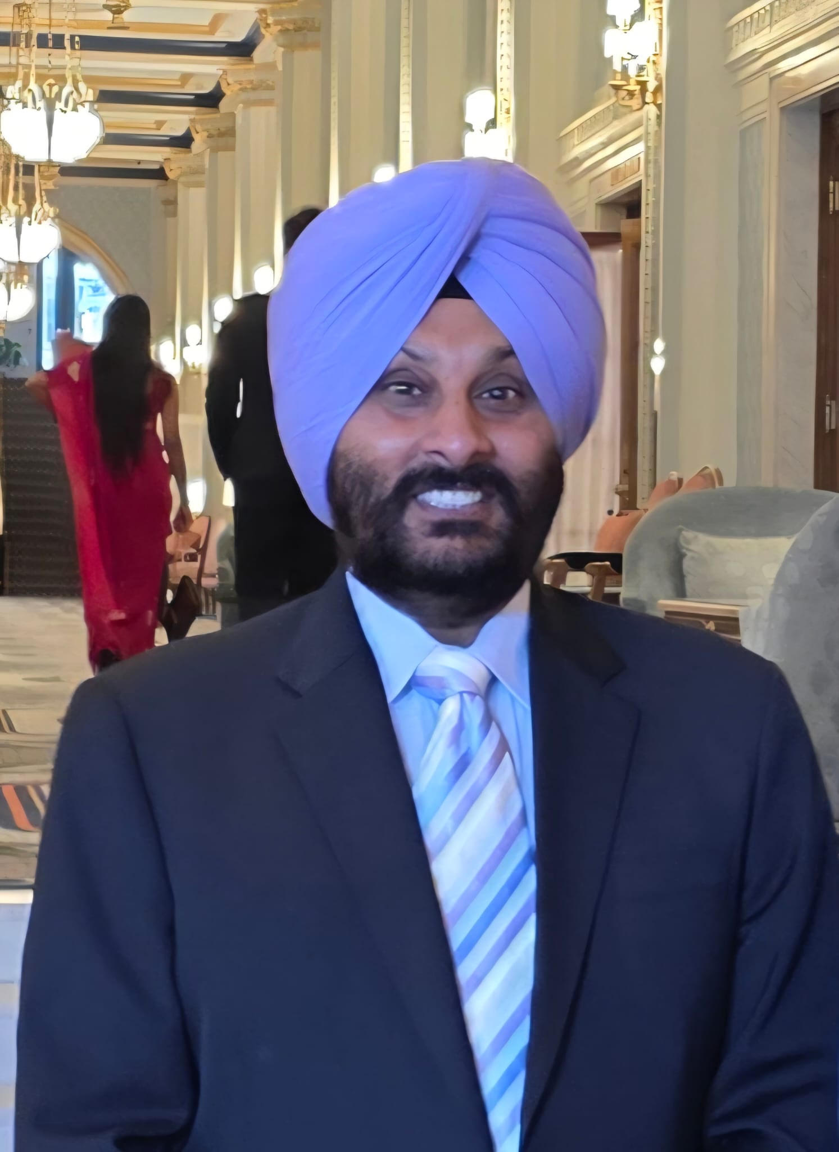
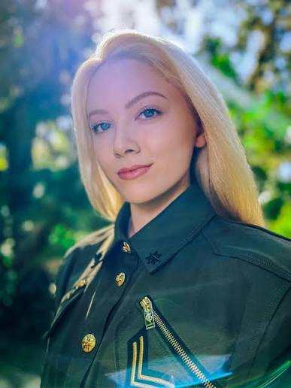
Panel 4: Religious Leaders
Fight Against Antisemitism and Hate
Panelists
Abedaleah Almaala
Yuval David
Moderator:
Rabbanit Alissa Thomas-Newborn
Nrip Singh
Jayne Zirkle

Slide 39
AMMWEC’s
National Coalition Conference 2026
UNITED AGAINST ANTISEMITISM & HATE:
Protecting Our Communities
July 13, 2026
Washington DC

Slide 40
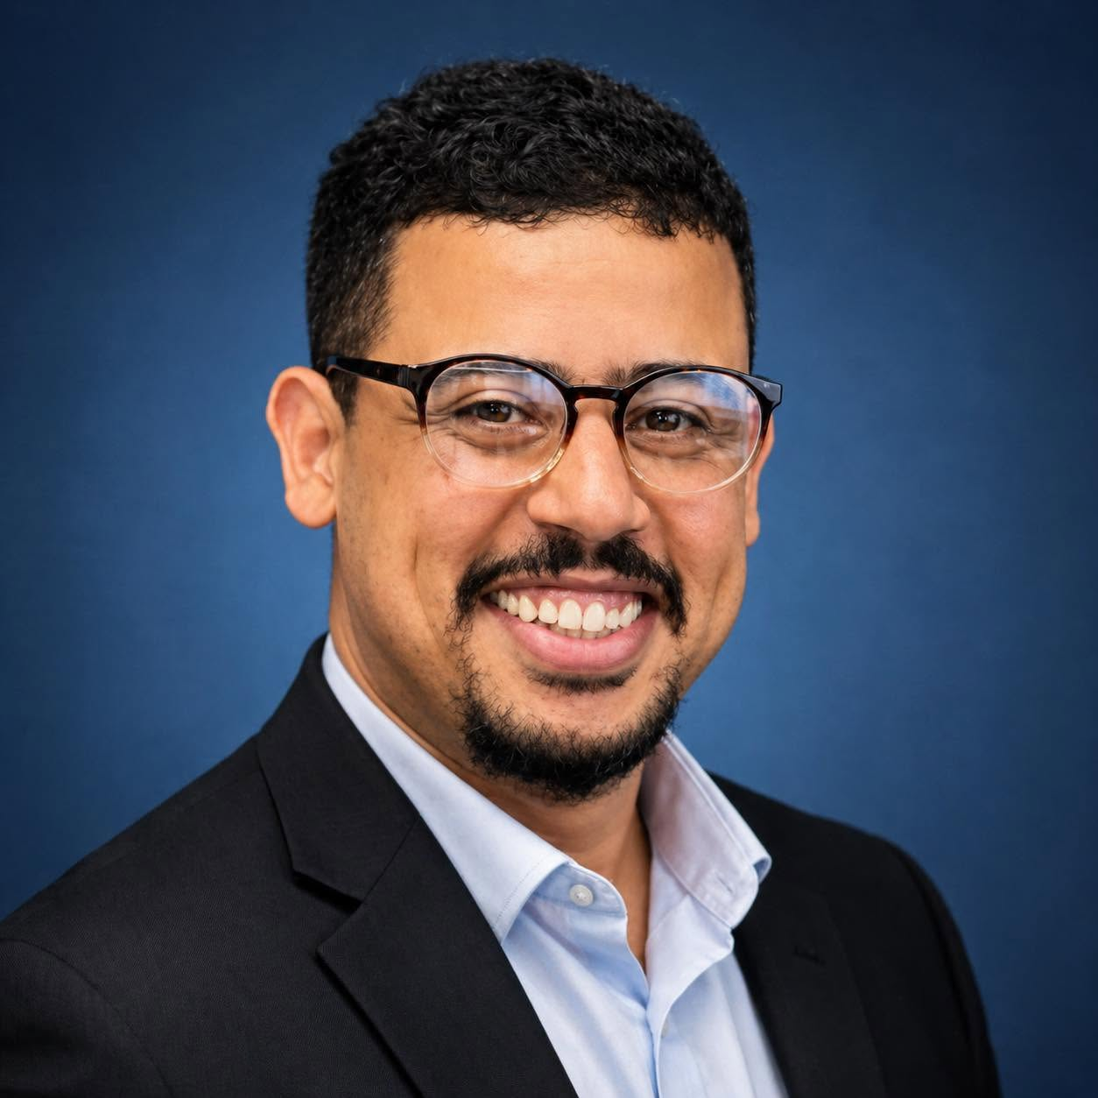
Speaker:
Mustapha Ezzarghani
Mustapha Ezzarghani is a Moroccan-American author, journalist, public speaker, and peace activist who is widely recognized for his advocacy in promoting Muslim-Jewish dialogue and Arab-Israeli reconciliation

Slide 41
AMMWEC’s
National Coalition Conference 2026
UNITED AGAINST ANTISEMITISM & HATE:
Protecting Our Communities
July 13, 2026
Washington DC

Slide 42
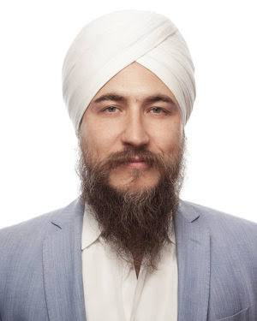
Speaker:
Simran Singh Stuelpnagel
He serves as a core leadership figure within the International Religious Freedom (IRF) Secretariat, the operational arm that coordinates the IRF Roundtable.

Slide 43
AMMWEC’s
National Coalition Conference 2026
UNITED AGAINST ANTISEMITISM & HATE:
Protecting Our Communities
July 13, 2026
Washington DC

Slide 44
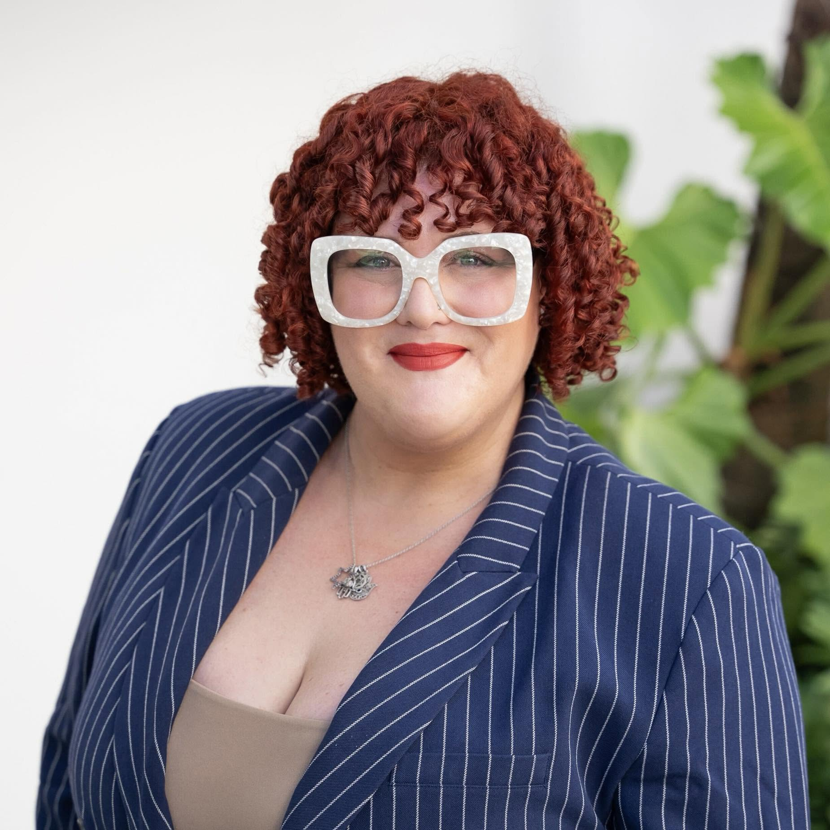
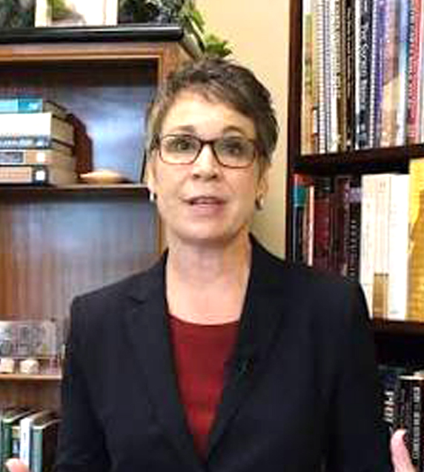
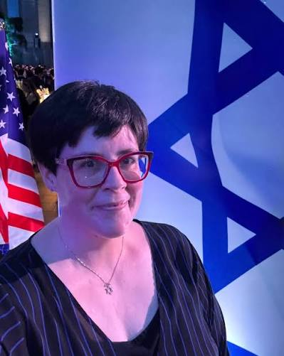
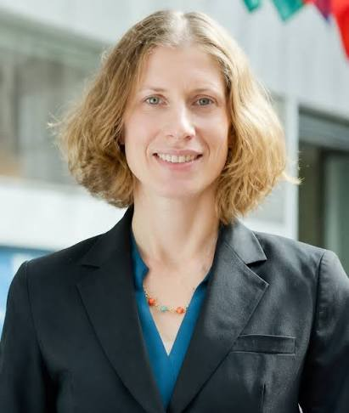
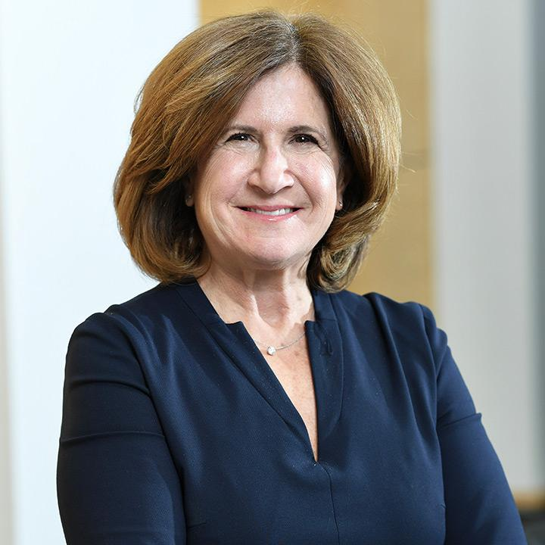
Panel 5: Interfaith Bridge Building on Campus: Faculty Perspectives
Panelists:
Dr. Carrie Wood
Dr. Amy Milligan
Moderator:
Sarah Livingston, AEN
Professor Donna Gitter
Professor Leslie Tenzer

Slide 45
AMMWEC’s
National Coalition Conference 2026
UNITED AGAINST ANTISEMITISM & HATE:
Protecting Our Communities
July 13, 2026
Washington DC

Slide 46
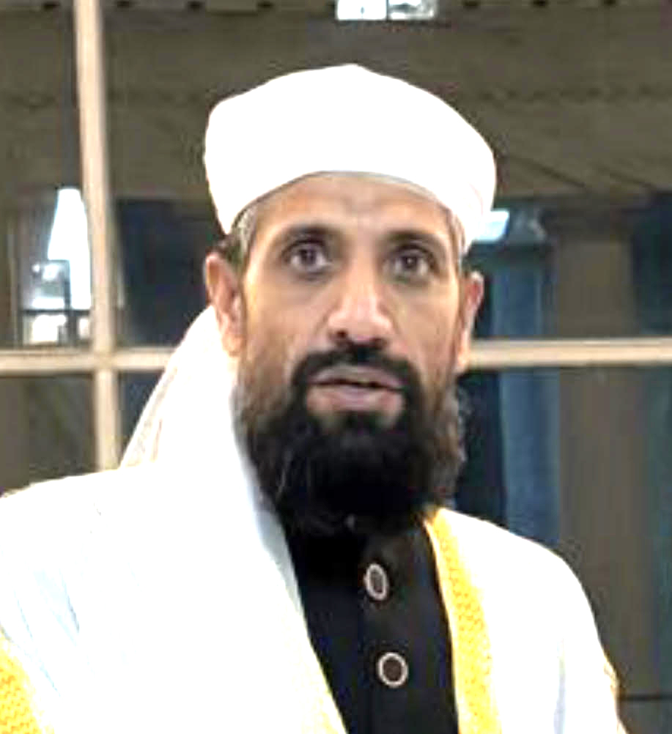
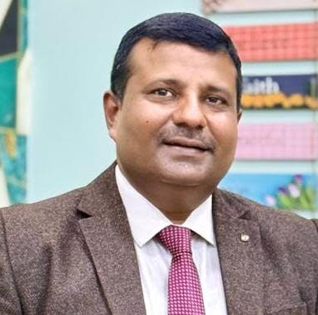


Pakistan Delegation
United for Abrahamic Unity
Panelists:
Imam Sajjad
Pastor Shahid
Kashif Mirza
Evangelist Rashid Gill

Slide 47
AMMWEC’s
National Coalition Conference 2026
UNITED AGAINST ANTISEMITISM & HATE:
Protecting Our Communities
July 13, 2026
Washington DC

Slide 48

Closing Remarks and Vote of Thanks
Anila Ali
Founder and President of
AMMWEC

Slide 49
AMMWEC’s
National Coalition Conference 2026
UNITED AGAINST ANTISEMITISM & HATE:
Protecting Our Communities
July 13, 2026
Washington DC

Slide 50
Musical Performance
Speaker:
Mustapha Ezzarghani
Ghazal Mizrahi is a New York-based Iranian-Jewish-American international vocal artist, singer, and vocal coach. She sings in over 50 languages to bridge cultures and faiths, and is known for her Persian, Hebrew, French, and English songs. Follow her work on Instagram or stream her music on Spotify.
Play Video

Slide 51


Slide 52


SHARE YOUR
FEEDBACK WITH US
Scan the QR CODE and share your experience

Slide 53

SCAN & GET IN TOUCH WITH US
#AMMWEC
#AMMWECCoalition
#Antisemitism
#HatehurtsUsAll
#UniteAgainstHate

